Slide 1

Night watch
…with QA
Carsten Sandtner (@casarock) mediaman// Gesellschaft für Kommunikation mbH

Slide 2

about:me
Carsten Sandtner @casarock
Head of Software Development
//mediaman GmbH

Slide 3



Slide 4

Testing

Slide 5
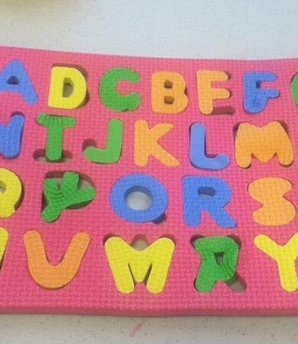
Unit Tests

Slide 6
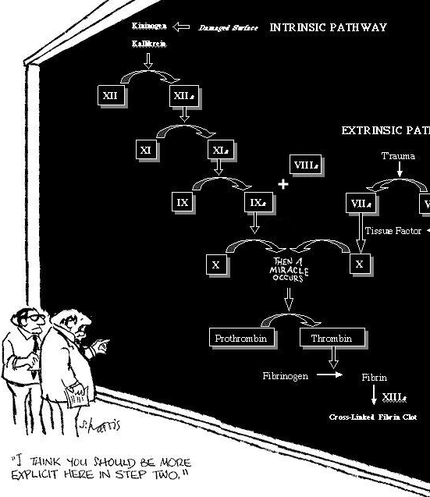
Integration Tests

Slide 7

System Tests
National Museum of American History Smithsonian Institution - https://flic.kr/p/e6s1Lr

Slide 8

User Acceptance Tests
Brett Jordan - https://flic.kr/p/7ZRSzA

Slide 9








Requirements
UAT
Preliminary design
System Test
Detailed design
Integration Test
Implementation
Unit Test

Slide 10








Requirements
UAT
Preliminary design
System Test
Detailed design
Integration Test
Implementation
Unit Test

Slide 11
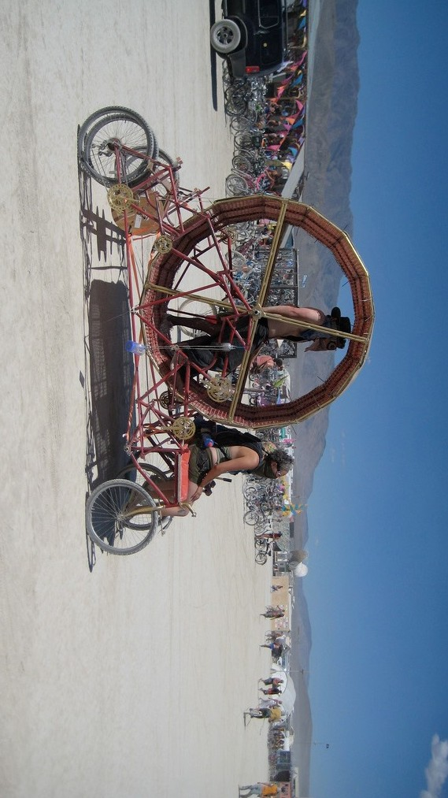
by 7263255 - https://flic.kr/p/6YgDNN

Slide 12


Slide 13


Slide 14
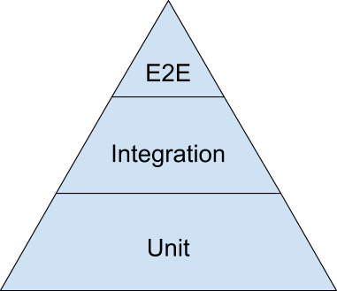


Testing pyramid
easy to automate
# of Tests

Slide 15


TDD
Implementation
Unit Test

Slide 16


Detailed design
Integration Test
Implementation
UUnniitt TTeesstt

Slide 17

Preliminary design
System Test
Detailed design
Integration Test
Implementation
Unit Test

Slide 18

Automated E2E Test

Slide 19





Slide 20





Slide 21


Slide 22
„Nightwatch.js is an easy to use Node.js based End- to-End (E2E) testing solution for browser based apps and websites. It uses the powerful Selenium WebDriver API to perform commands and assertions on DOM elements.“
– http://nightwatchjs.org/

Slide 23
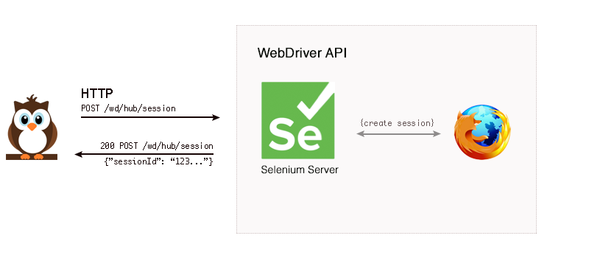
Nightwatch & WebDriver

Slide 24
Features
•
Clean syntax
•
Build-in test runner
•
support for CSS and Xpath Selectors
•
Grouping and filtering of Tests
•
Saucelab and Browserstack support
•
Extendable (Custom Commands)
•
CI support!

Slide 25
Installation
$ npm install [-g] nightwatch
… and Download Selenium-Server-Standalone!
Done.

Slide 26
Nightwatch project structure
├──bin/
| ├──chromedriver
| └──seleniumdriver.jar
|
├──data/
| └──globals.js
|
├──reports/
| └──fancyreports.xml
|
├──tests/
| ├──meaningfultest1.js
| ├──meaningfultest2.js
| └── …
└──nightwatch.js[on]

Slide 27
Nightwatch.js
module.exports = { "src_folders": ["tests"], "output_folder": "reports", "custom_commands_path": "",
"custom_assertions_path": "",
"page_objects_path": "./objects/", "globals_path": "",
"selenium": {
"start_process": true,
"server_path": "bin/selenium-server-standalone-2.53.1.jar", "log_path": "",
"host": "127.0.0.1",
"port": 4444,
"cli_args": {
"webdriver.chrome.driver": "./bin/chromedriver", "webdriver.ie.driver": "", "webdriver.gecko.driver" : "./bin/geckodriver090"
}
},

Slide 28
Nightwatch.js - Test setup.
"test_settings": {
"default": {
"launch_url": "http://localhost", "selenium_port": 4444, "selenium_host": "localhost", "silent": true,
"screenshots": {
"enabled": false, "path": ""
},
"desiredCapabilities": { "browserName": "chrome", "marionette": true
}
},
“staging“: {
. . .
},

Slide 29
Nightwatch.js - Browser setup
"chrome": {
"desiredCapabilities": { "browserName": "chrome", "javascriptEnabled": true, "acceptSslCerts": true
}
}
}
};

Slide 30
Simple Nightwatch test
module.exports = {
'Google Webtechcon' : function (client) { client
.url('http://www.google.com')
.waitForElementVisible('body', 1000)
.assert.title('Google')
.assert.visible('input[type=text]')
.setValue('input[type=text]', 'webtechcon')
.waitForElementVisible('button[name=btnG]', 1000)
.click('button[name=btnG]')
.pause(1000)
.assert.containsText('#rso > div.g > div > div > h3 > a', 'WebTech Conference 2016')
.end();
}
};

Slide 31
Test execution
$ nightwatch [-c nightwatch.js] tests/simplegoogle.js

Slide 32
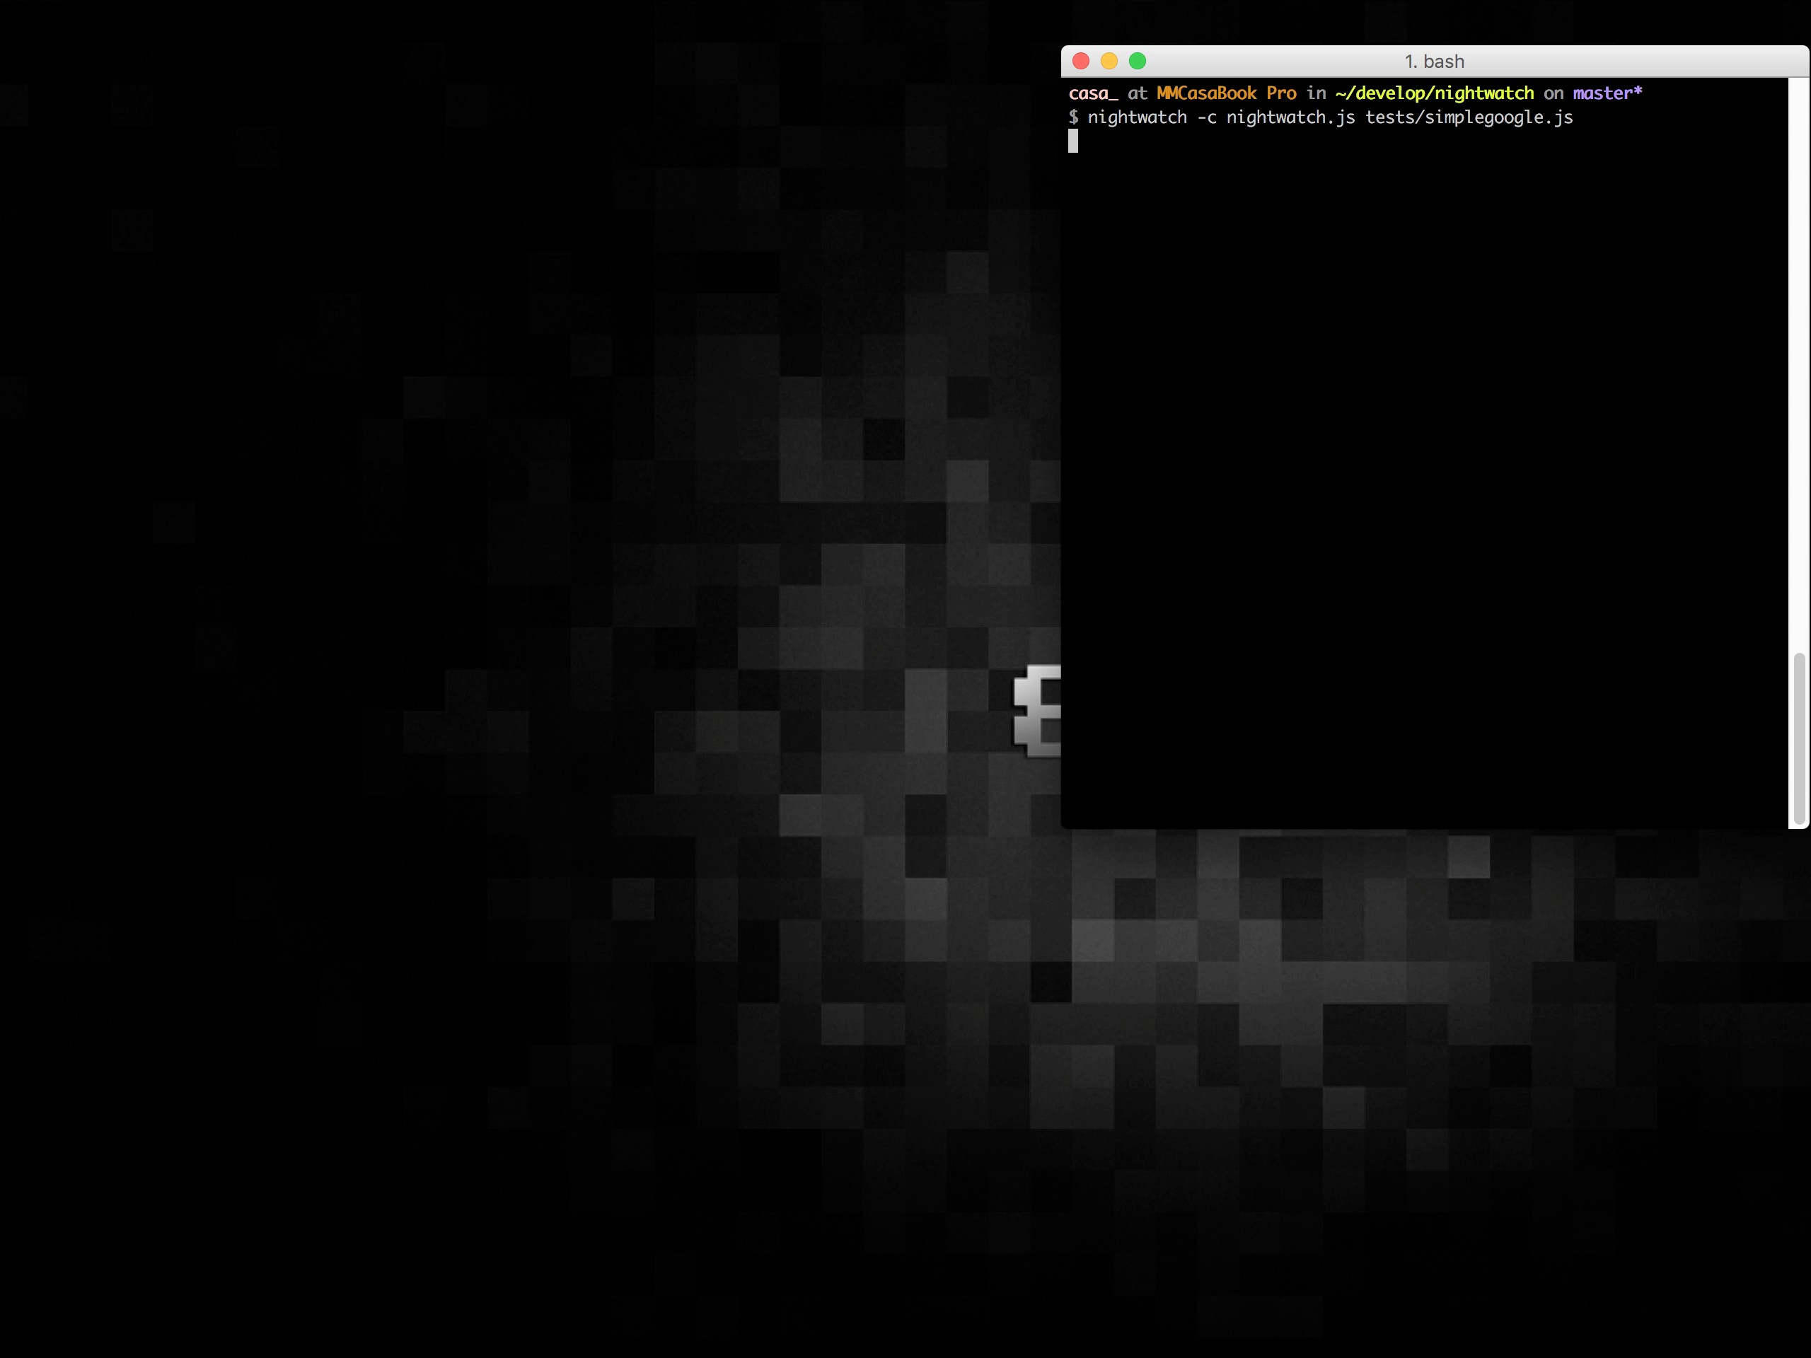

Slide 33
Tests in detail

Slide 34
Arrange and assert
module.exports = {
'Google Webtechcon' : function (client) { client
arrange
.url('http://www.google.com')
.waitForElementVisible('body', 1000)
.assert.title('Google')
.assert.visible('input[type=text]')
assert
}
};
.end();

Slide 35
Arrange, action and assert
module.exports = {
'Google Webtechcon' : function (client) { client
.url('http://www.google.com')
.waitForElementVisible('body', 1000)
arrange
.assert.title('Google')
.assert.visible('input[type=text]')
assert
.setValue('input[type=text]', 'webtechcon')
.waitForElementVisible('button[name=btnG]', 1000)
action
.click('button[name=btnG]')
assert
.pause(1000)
.assert.containsText('#rso > div.g > div > div > h3 > a', 'WebTech Conference 2016')
.end();
}

Slide 36

Hardcoded values?

Slide 37
Hardcoded values
module.exports = {
'Google Webtechcon' : function (client) { client
.url('http://www.google.com')
.waitForElementVisible('body', 1000)
.assert.title('Google')
.assert.visible('input[type=text]')
.end();
}
};

Slide 38
Using globals
module.exports = {
'Google Webtechcon' : function (client) {
var globals = client.globals;
client
.url(globals.url)
.waitForElementVisible('body', 1000)
.assert.title(globals.static.pageTitle)
.assert.visible(globals.selectors.searchField)
.end();
}
};

Slide 39
Define globals
module.exports = {
url: 'http://www.google.com', selectors: {
'searchField': 'input[type=text]'
},
static: {
'pageTitle': 'Google'
}
}
Save as data/google.js

Slide 40
Add to config (test-settings)
module.exports = {
. . .
"test_settings": { "default": {
"launch_url": "http://localhost",
"selenium_port": 4444, "selenium_host": "localhost",
"silent": true, "screenshots": {
"enabled": false, "path": ""
},
"desiredCapabilities": { "browserName": "chrome",
"marionette": true
},
"globals": require('./data/google')
},
. . .

Slide 41


Slide 42
Use Page Objects!

Slide 43
Using Page Objects
module.exports = {
'url': 'http://www.google.com',
'elements': {
'searchField': 'input[type=text]'
}
};
Save as object/google.js

Slide 44
Add objects to config
module.exports = { "src_folders": ["tests"], "output_folder": "reports", "custom_commands_path": "",
"custom_assertions_path": "",
"page_objects_path": "./objects/",
"globals_path": "",
"selenium": {. . .},
"test_settings": {. . .}
};

Slide 45
Add objects to config
module.exports = {
'Google Webtechcon' : function (client) {
var googlePage = client.page.google(), globals = client.globals;
googlePage.navigate()
.waitForElementVisible('body', 1000)
.assert.title(globals.static.pageTitle)
.assert.visible('@searchField')
.end();
}
};

Slide 46
More PageObjects awesomeness
module.exports = {
'url': 'http://www.some.url', 'elements': {
'passwordField': 'input[type=text]', 'usernameField': 'input[type=password]', 'submit': 'input[type=submit]'
},
commands: [{
signInAsAdmin: function() {
return this.setValue('@usernameField', 'admin')
.setValue('@passwordField', 'password')
.click('@submit');
}
}]
};

Slide 47
In your test
module.exports = {
'Admin log in' : function (browser) {
var login = browser.page.admin.login();
login.navigate()
.signInAsAdmin();
browser.end();
}
};

Slide 48
Grouping tests
$ nightwatch --group smoketests
$ nightwatch --skipgroup smoketests
$ nightwatch --skipgroup login,whatever

Slide 49
Test groups
|
├──tests/
| ├──smoketests/
| | ├──meaningfulTest1.js
| | ├──meaningfulTest2.js
|
|
|
|
| └── ……
└──login/
├──authAndLogin.js
└── ……

Slide 50
Tag your tests
$ nightwatch --tag login
$ nightwatch --tag login --tag something_else
$ nightwatch --skiptags login
$ nightwatch --skiptags login,something_else

Slide 51
In your test
module.exports = {
'@tags': ['login', 'sanity'],
'Admin log in' : function (browser) {
var login = browser.page.admin.login();
login.navigate()
.signInAsAdmin();
browser.end();
}
};

Slide 52
Demo

Slide 53
Nightwatch is extendable!
•
Write custom commands
•
add custom assertions
•
write custom reporter

Slide 54
Nightwatch is Javascript!
•
Using Filereaders
CSV, Excel etc.
write helpers if needed!
•

Slide 55


Slide 56

Nightwatch @Mediaman

Slide 57
The problem

Slide 58
Before Nightwatch

Slide 59
The solution

Slide 60
Requirements
UAT
Preliminary design
✓
✓
System Test
Detailed design
✓
✓
Integration Test
Implementation
✓
✓
Unit Test

Slide 61
Thanks!
Carsten Sandtner
(◡‿◡✿)
@casarock
sandtner@mediaman.de https://github.com/casarock

